Slide 1
Distributed Systems
Distributed Dead lock Detection: A diffusion Computation based Algorithm, A Global state Detection Based Algorithm
by
Ms. Neha Shukla
(B.Tech, M.Tech, Ph.D*)
CSE Department
KIET Group of Institutions

Slide 2
Contents
Distributed Dead lock Detection
A diffusion Computation based Algorithm
A Global state Detection Based Algorithm

Slide 3
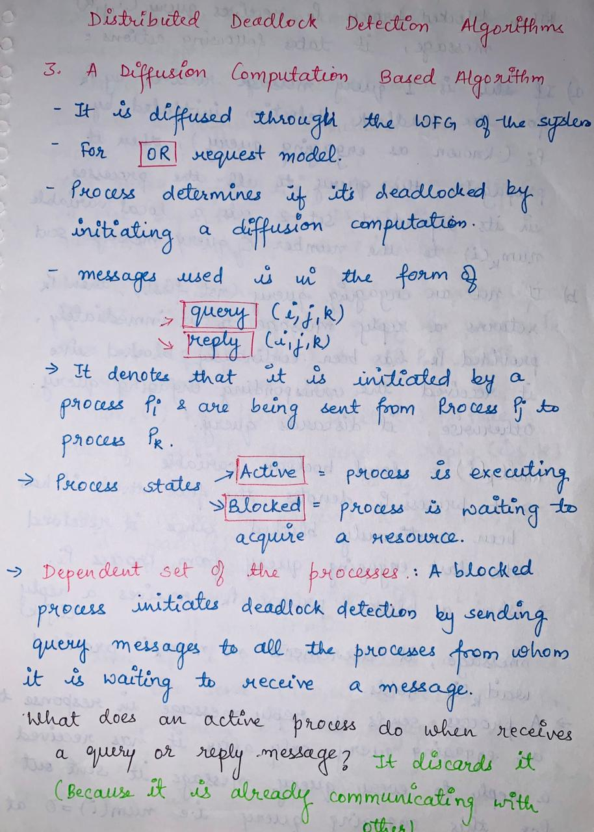

Slide 4
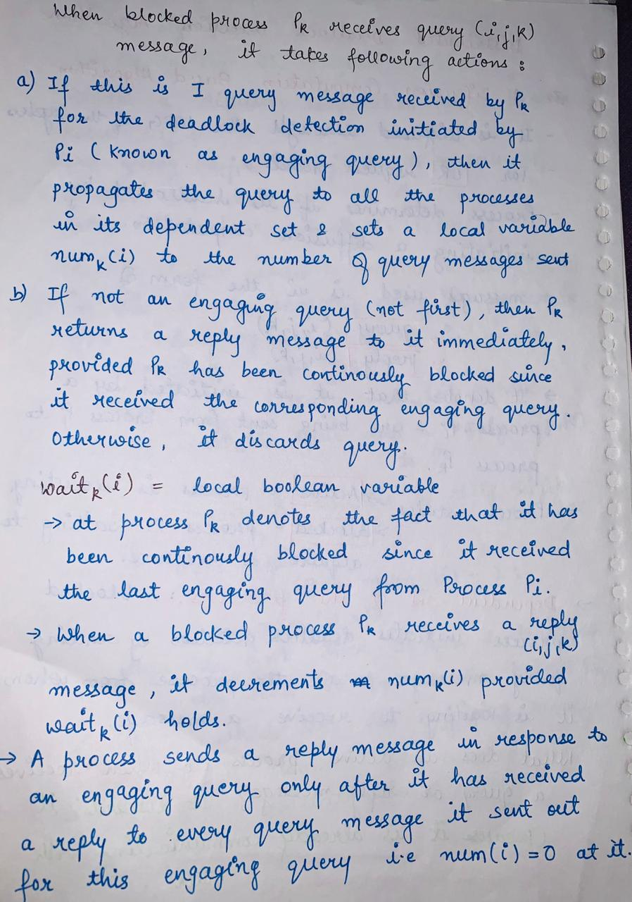

Slide 5
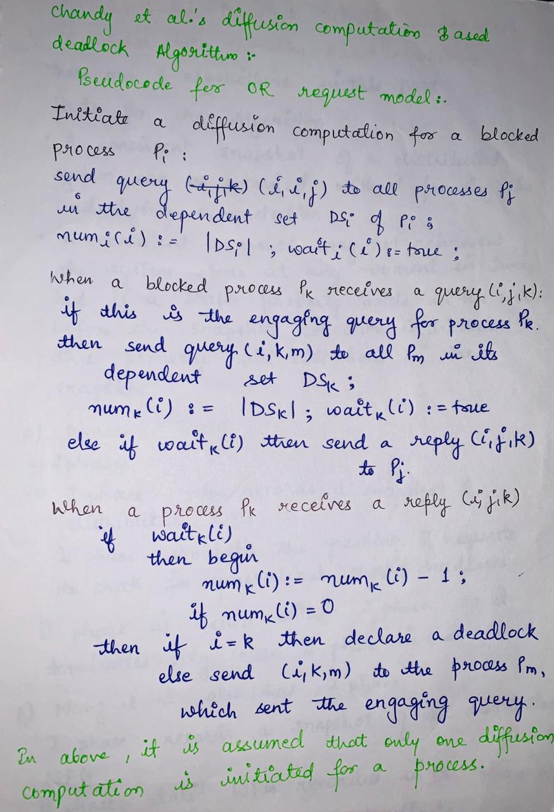

Slide 6
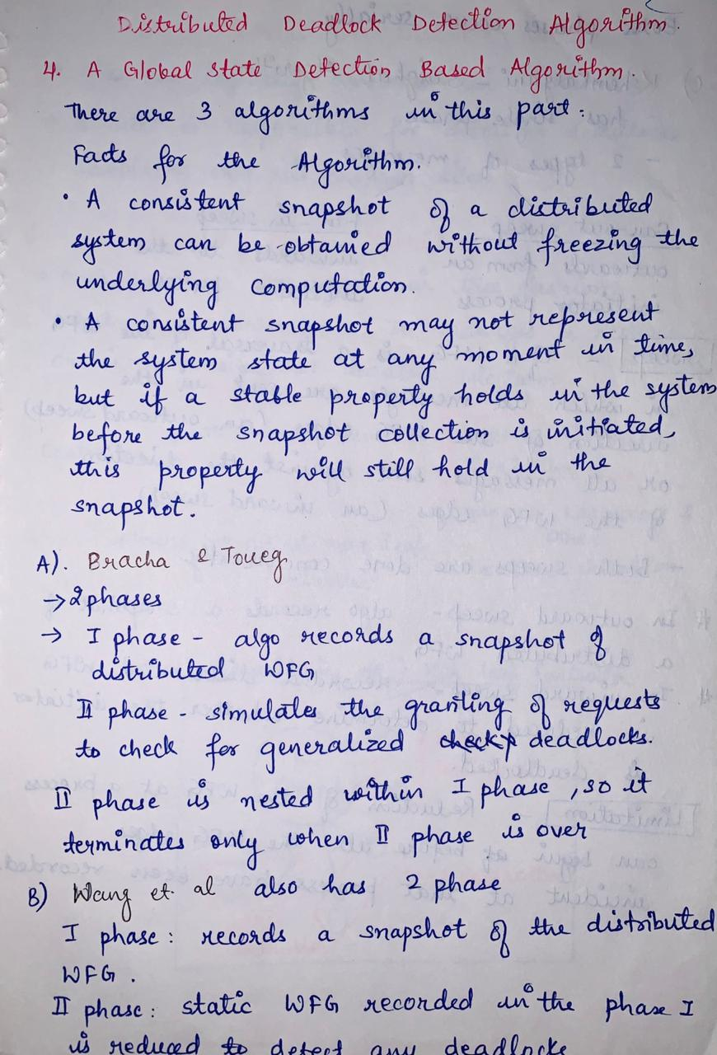

Slide 7
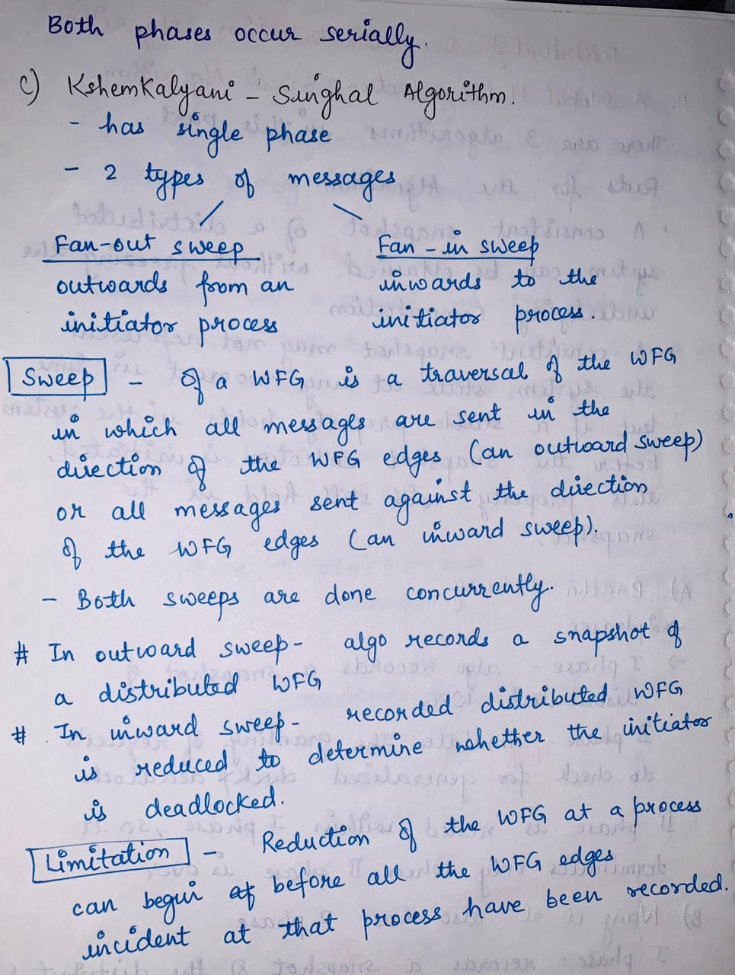

Slide 8
Thank
You

